Slide 1
Contract Monthly Claim System (CMCS)
SubtitlePortfolio of Evidence — Programming 2B (PROG6212)

Slide 2
ST10442454 – Ndivhuwo Wandile Ranwedzi
FINAL POE PRESENTATION

Slide 3
Homepage
HOMEPAGE INFORMATION AND SCREENSHOTS

Slide 4
Welcome to CMCS
A platform built to simplify and streamline monthly claim submissions.
Supports both lecturers and administrators.
Provides a user‑friendly and efficient experience for all stakeholders.

Slide 5
About the System
CMCS is a practical web‑based application reflecting real academic workflows.
Automates:
  Claim submissions
  Document uploads
  Multi‑level approvals (Lecturers → Coordinators → Managers → HR)
Built with modern software practices ensuring accuracy, accountability, and usability.

Slide 6
What We Do
Lecturers: Submit monthly claims easily.
Programme Coordinators: Verify and approve claims.
Academic Managers: Oversee final approvals and compliance.
HR: Track claim status, finalize payments, and manage lecturer details.
Transparent tracking from submission to settlement.

Slide 7
Key Features
Secure document upload.
Real‑time claim status tracking.
Multi‑role access with tailored dashboards.
Automated CSV and PDF report generation.
Consistent and reliable information across all user roles.

Slide 8
Value of CMCS
Efficiency: Reduces manual paperwork and repetitive tasks.
Transparency: Lecturers can track claims at every stage.
Accuracy: Automated calculations minimize errors.
Accountability: Clear approval workflow ensures compliance.
Scalability: Built on .NET Core MVC for future enhancements.

Slide 9
Contact Us
Email: support@cmcs.edu.za
Phone: +27 11 000 0000
Office Hours: Monday to Friday, 08:00 – 16:30
Dedicated to making the claim process smooth and stress‑free.

Slide 10
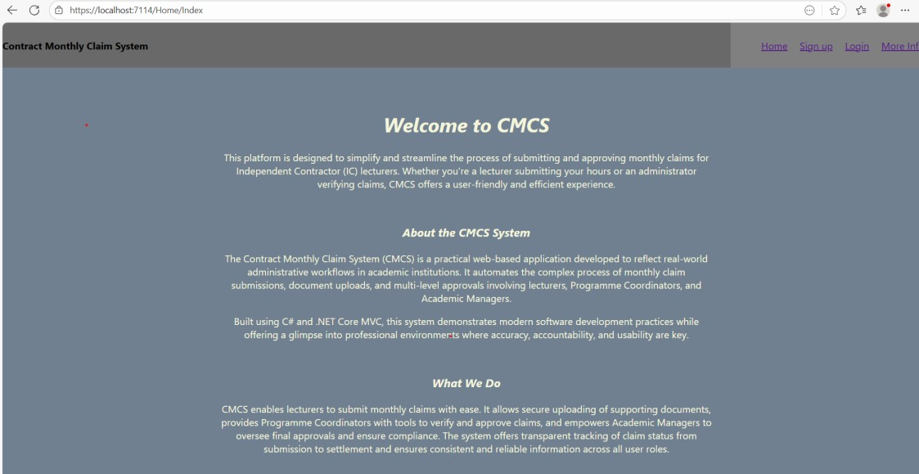

Slide 11
Sign Up Page
REGISTRATION/SIGN UP INFORMATION AND SCREENSHOT

Slide 12
Sign up
Provides a registration form for new users.
Collects essential details:
Username
Password
Email
Role (Lecturer, Coordinator, Manager, HR)
Ensures each user is correctly identified and assigned a role.
Sign Up Page (Features)
Validation: Displays errors if fields are missing or invalid.
Role Selection: Dropdown ensures correct access level.
Security: Password field hidden during entry.
User Experience: Clean, centered layout with clear labels.

Slide 13
Sign Up Page (Value)
Streamlines onboarding of new users.
Prevents incorrect role assignment.
Ensures data integrity with validation.
Provides a professional, user‑friendly interface.

Slide 14
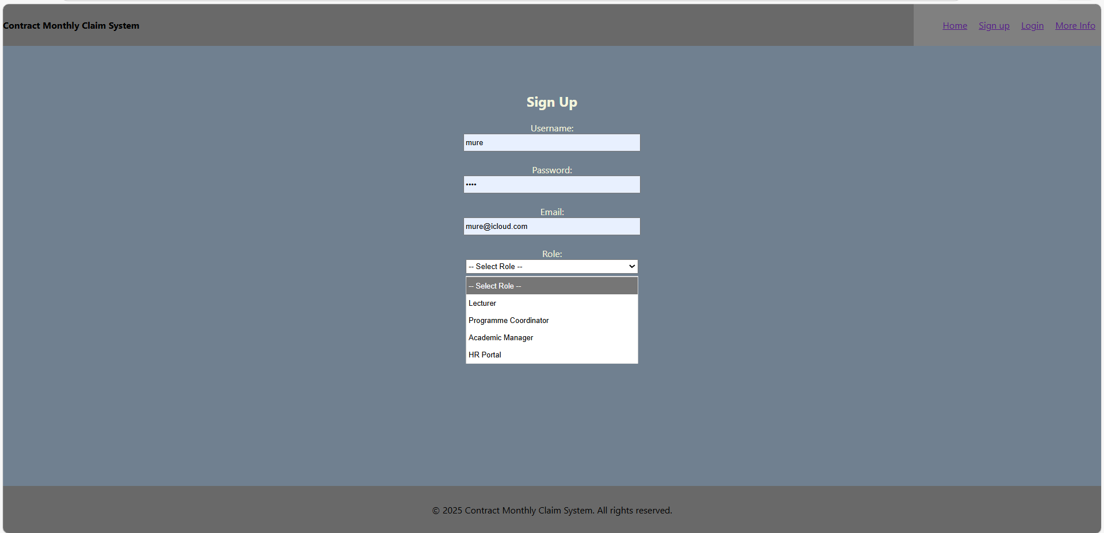

Slide 15
Login Page
LOGIN INFORMATION AND SCREENSHOT

Slide 16
Login
Allows registered users to access the system.
It requires the username ,password, role selection
It connects directly to the homecontroller.login for authentication
Login Page (Features)
Welcome Message: Displays personalized greeting after successful sign‑up.
Role Dropdown: Ensures correct dashboard access (Lecturer, Coordinator, Manager, HR).
Security: Password input is masked.
Simple Layout: Easy navigation for all user types.

Slide 17
Login Page (Value)
Connects directly to HomeController.Login for authentication.
Combined Value
Provides secure access to CMCS.
Ensures users only see features relevant to their role.
Enhances accountability by linking actions to specific users.
Creates a smooth, professional entry point into the system.
Together, Sign Up and Login form the foundation of system security.
They ensure:
Username, Password, Role selection
Connect directly to the homepage .

Slide 18
Login Page (Features)
Welcome Message: Displays personalized greeting after successful sign‑up.
Role Dropdown: Ensures correct dashboard access (Lecturer, Coordinator, Manager, HR).
Security: Password input is masked.
Simple Layout: Easy navigation for all user types.

Slide 19
Login Page (Value)
Provides secure access to CMCS.
Ensures users only see features relevant to their role.
Enhances accountability by linking actions to specific users.
Creates a smooth, professional entry point into the system.

Slide 20
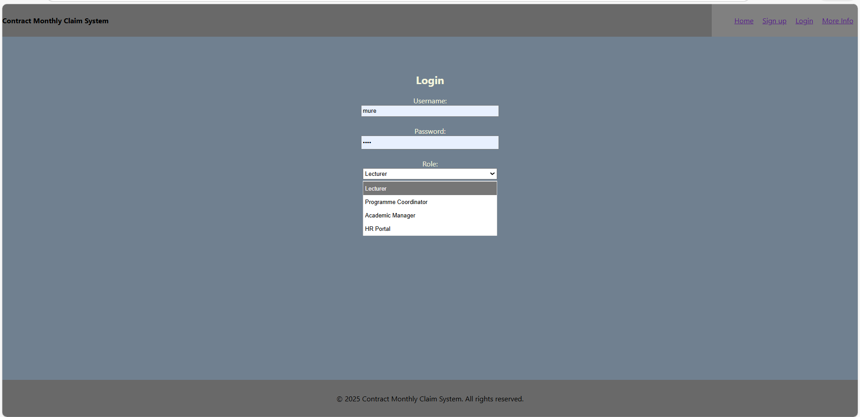

Slide 21
The roles web Pages

Slide 22
Lecturer Page
LECTURER INFORMATION AND SCREENSHOT

Slide 23
Lecturer Dashboard Overview
Purpose of This View
Welcomes the logged-in lecturer
Allows submission of monthly claims
Provides access to track claim progress
Displays recent claim activity notice
Key Features
Displays lecturer name using @Model.Name
Offers two main actions:
  Submit Claim
  Track Claim
Uses TempData.Keep("LecturerName") to retain user context

Slide 24
Lecturer Dashboard UI Elements
Interface Elements
Welcome message dynamically bound to the model
Submit Claim button
  Uses <form asp-action="SubmitClaim">
  Sends GET request to HomeController
Track Claim button
  Includes hidden field lecturerFullName
  Redirects to claim tracking page
Visual Styling
Light-colored UI (beige theme)
Centered container with padding and spacing
Clean, simple navigation for lecturers

Slide 25
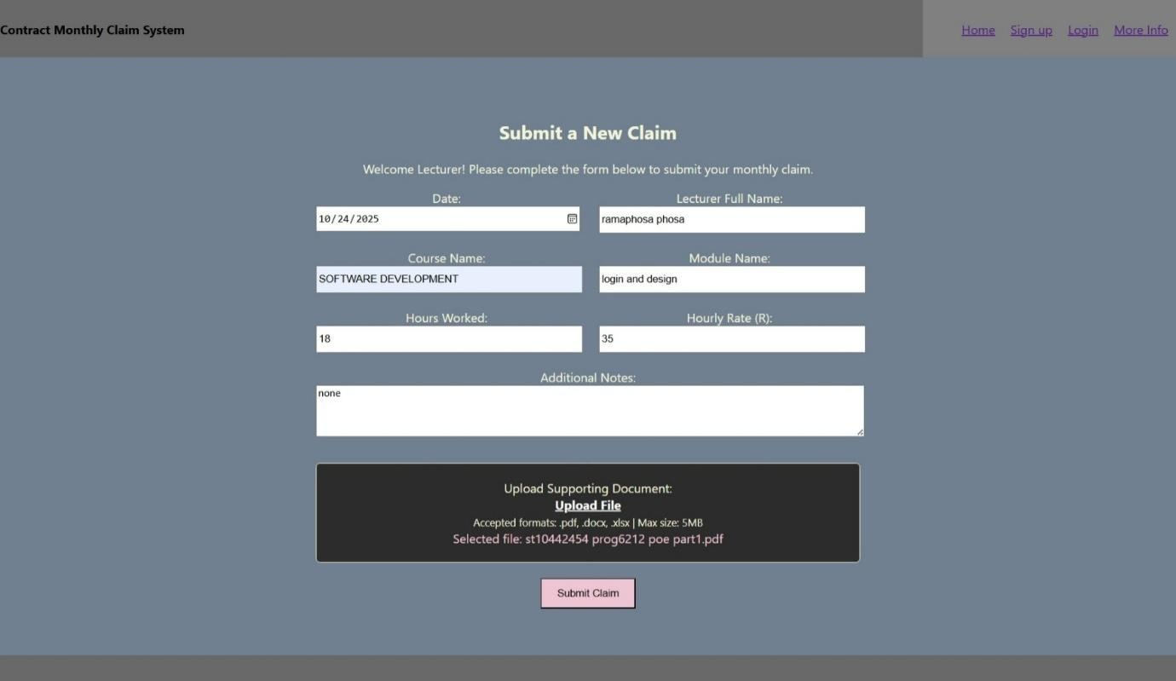

Slide 26
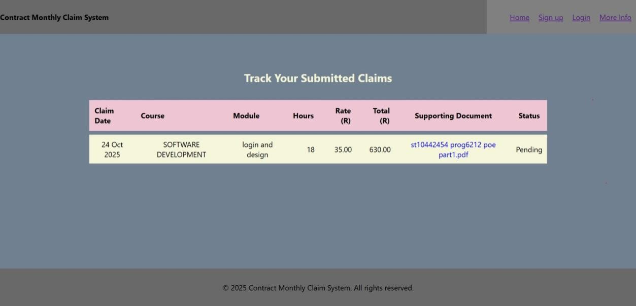

Slide 27
Coordinator Page
COORDINATOR INFORMATION AND SCREENSHOT

Slide 28
Coordinator Dashboard Overview
Purpose of This View
Provides all Programme Coordinators with:
  Access to pending, approved, and rejected claims
  Ability to approve or reject claims
  Overview of lecturer submissions
.

Slide 29
Model Input
Uses:
@model List<monthlyclaim.Models.Coordinator>
Receives a list of claim records

Slide 30
Claim Categorization Logic
Dashboard Automatically Splits Claims Into:
Pending Claims
  Status: “Pending” or “Pending Coordinator Review”
Approved Claims
  Status: “Approved by Coordinator”
Rejected Claims
  Status: “Rejected by Coordinator”

Slide 31
Pending Claims Table
Displayed Information Includes:
Claim ID
Lecturer Name
Course
Module
Hours Worked
Total Claim Amount
Supporting Document (View Link)
Submission Date
Current Status
Coordinator Actions
Approve button
Reject button

Slide 32
Approved & Rejected Claims
Approved Claims Section
Includes:
Claim ID
Lecturer Name
Total Amount
Status
Rejected Claims Section
Includes:
Claim ID
Lecturer Name
Total Amount
Status
Both tables use simple summaries and no action buttons.

Slide 33
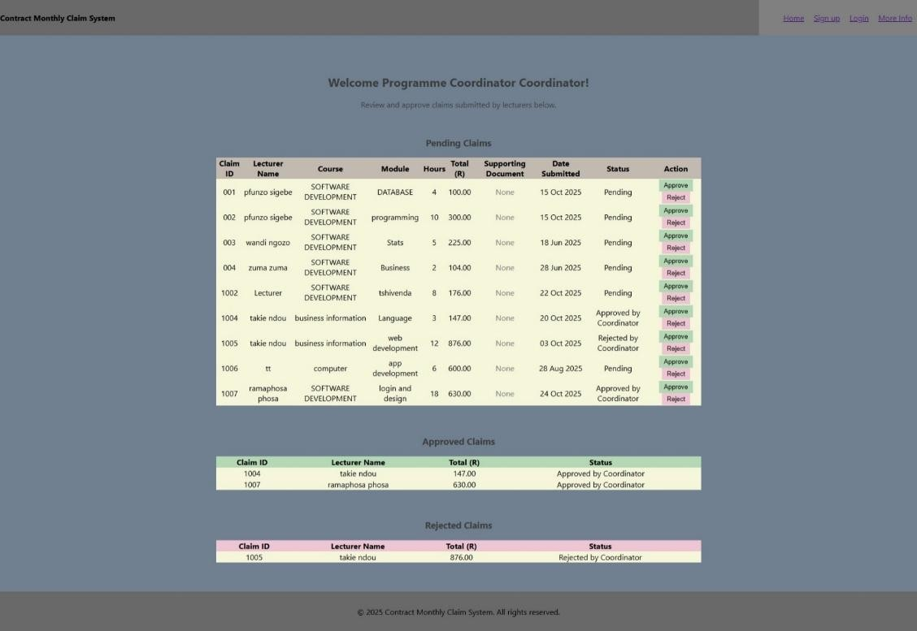

Slide 34
Programme Manager Page
PROGRAMME COORDINATOR INFORMATION AND SCREENSHOT

Slide 35
Academic Manager Dashboard
Purpose
The Academic Manager Dashboard provides the final stage of claim verification.
After the Programme Coordinator approves a claim, it reaches the Academic Manager for final approval or rejection.
.

Slide 36
Key Features
Pending Claims Table
Displays claims approved by the Coordinator and now waiting for the Manager.
Shows:
  Lecturer name
  Submission date
  Total amount
  Coordinator status
  Action buttons (Final Approve / Reject)
.

Slide 37
Approved Claims Table
Shows all claims that have been Final Approved by the Manager.
Displays:
  Lecturer name
  Submission date
  Total amount
  Final status
This ensures the Manager has clear oversight of both pending and completed tasks.
.

Slide 38
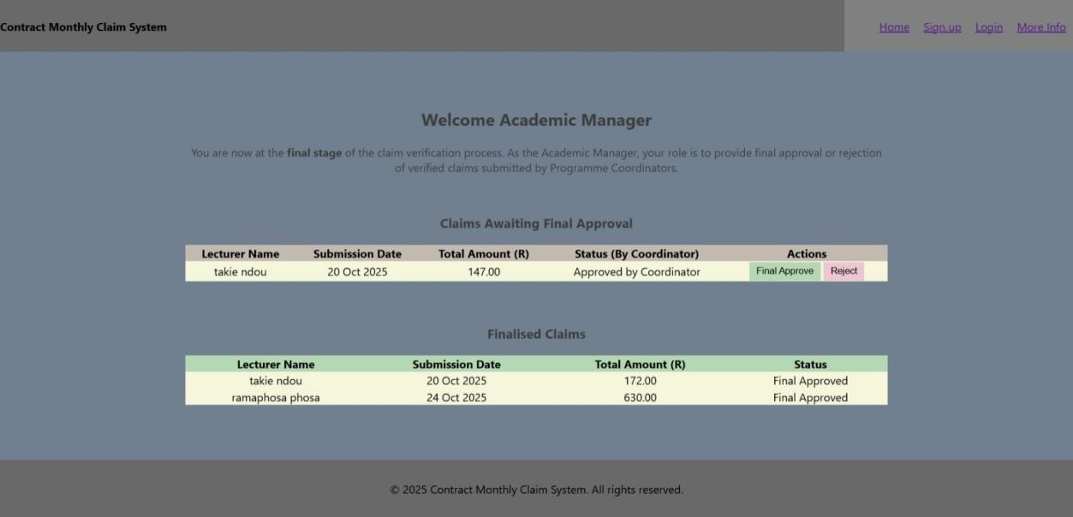

Slide 39
Hr Portal Page
HR PORTAL INFORMATION AND SCREENSHOT

Slide 40
HR Portal – Finalised Claims
Purpose
The HR portal manages all final approved claims, allowing HR to prepare payments, generate reports, and manage lecturer details.
Dashboard Summary Cards
Total Final Claims
Total Approved Amount (R)
Total Unique Lecturers
Pending Payments
These metrics give HR instant insight into payment workload and financial values.

Slide 41
Main HR Features
Filters
HR can filter claims by:
Lecturer name
Month
Export Options
Download CSV
Download PDF
Provides clean reporting for finance and auditing.

Slide 42
Finalised Claims Table
Displays:
Claim ID
Lecturer
Course + Module
Hours worked
Hourly rate
Total amount
Support document
Submission date
Status
HR actions
.

Slide 43
HR Actions
Edit Lecturer Information
  Update name, email, phone number, and bank details.
Mark Claim as Paid
  Records that payment has been processed.
This ensures lecturer records remain accurate and payments are properly tracked.

Slide 44
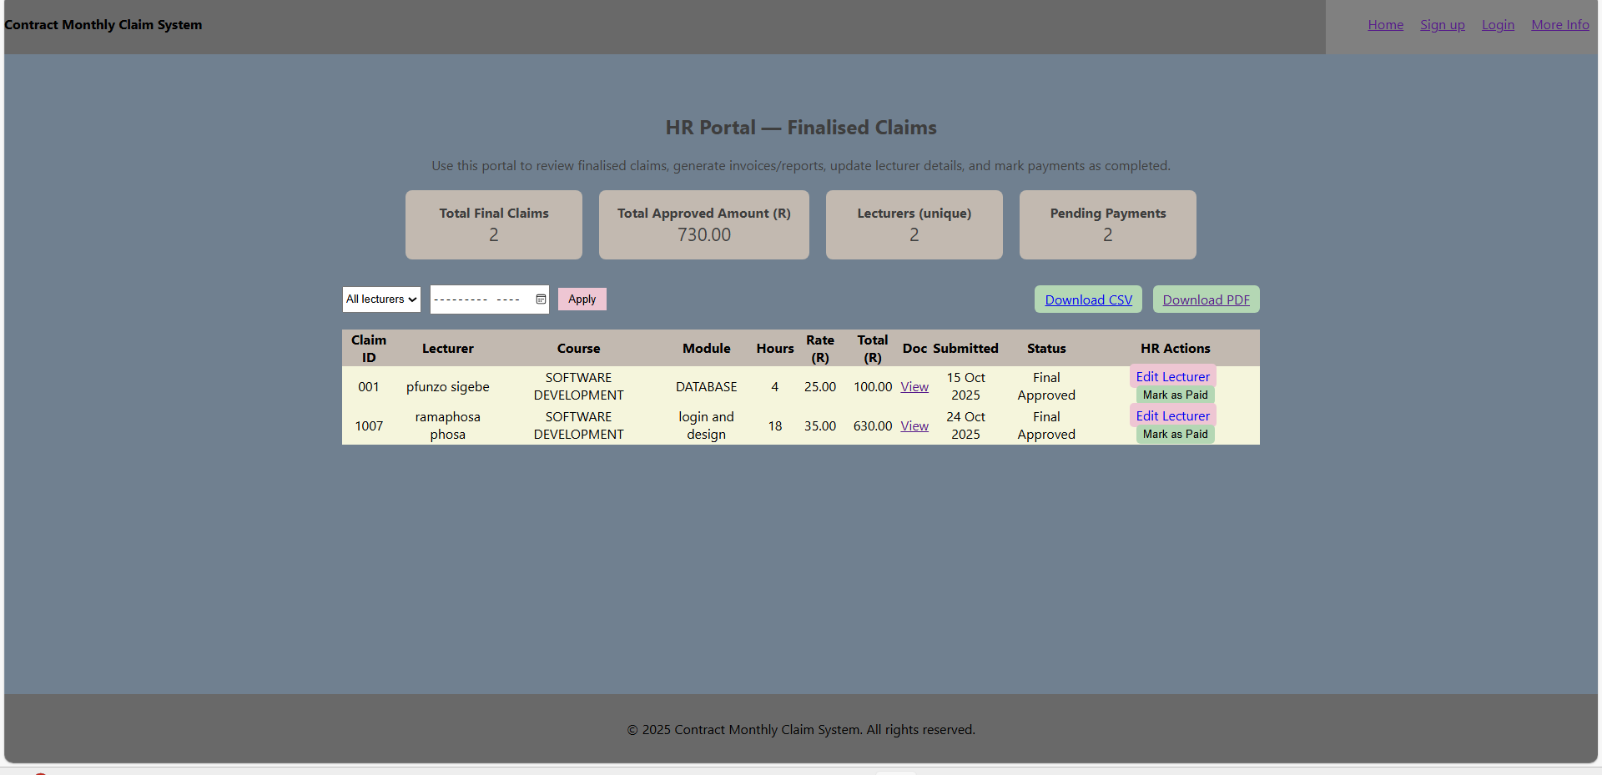

Slide 45
More info Page
MORE INFO INFORMATION AND SCREENSHOT

Slide 46
Integrity
CMCS is built on transparency, fairness, and accuracy.
Every claim goes through a careful verification process to ensure lecturers are compensated correctly.
Policy Compliance
The system follows institutional rules, using a multi-level approval workflow:
Lecturer →
Coordinator →
Academic Manager →
HR

Slide 47
This protects both the institution and the lecturer.
Trust & Security
Secure document handling
Role-based access
Clear, traceable workflows
CMCS ensures a reliable environment for all users.

Slide 48
What We Do
📁 Upload Claims
Lecturers upload monthly claims and supporting documents easily.
The system stores them securely and prepares them for review.
📝 Approval Workflow
Coordinators and Managers verify and approve claims:
Check completeness
Validate accuracy
Approve or reject

Slide 49
Status Tracking
Lecturers and administrators can track real-time status updates:
Submitted
Under Review
Approved / Rejected
Final Approved
Paid
This transparency reduces confusion and improves communication.

Slide 50
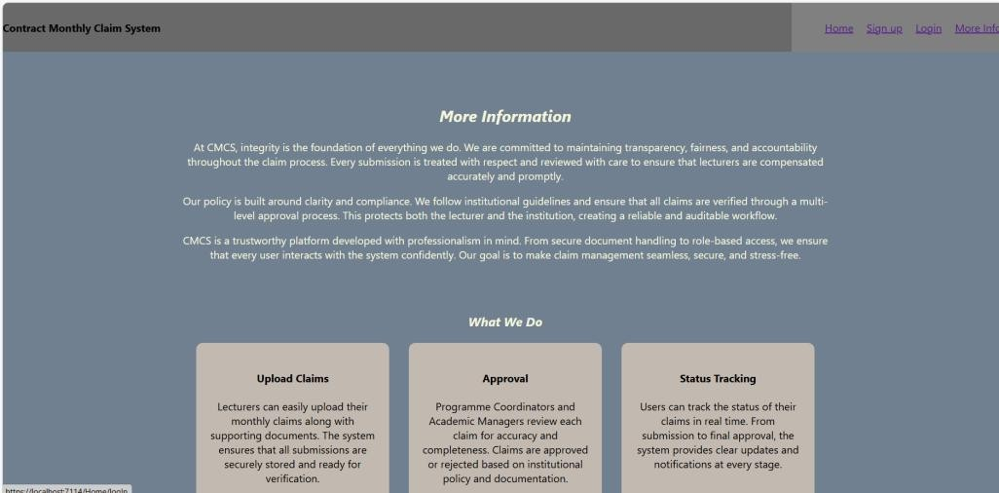

Slide 51
Conclusion
The CMCS Claim Management System simplifies the entire claims lifecycle, from submission to final payment.
Through clear interfaces, role-based workflows, and secure data handling, the system provides:
Efficiency – Reducing manual paperwork
Accuracy – Minimizing errors in claim calculations & approvals
Transparency – Real-time tracking for all users
Accountability – Multi-level verification ensures integrity
Professionalism – Reliable, secure, and user-friendly platform
Overall, CMCS improves productivity, enhances trust, and ensures lecturers are compensated fairly and on time.
It is a complete digital solution for modern claim management.
.

Slide 52
Thank You

